Slide 1
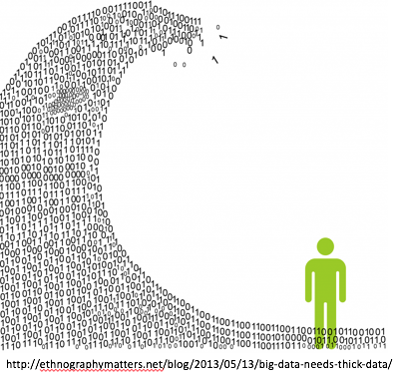
INFO3315 - HCI Human-Computer Interaction Lab notes
Week 4
Labs: Thursday 23 August

Slide 2
Announcement
All marks for Mini-Assignments 1 and 2 have been released
If your work was not marked, let your tutor know – student swaps have made the marking process difficult.
You may have been missed if you moved between labs.

Slide 3
Overview
Introduction (10 mins .. 10)
Individual: Getting started with Balsamiq (40 mins .. 50)
Group: Create Group Google Folder (10 mins .. 60)
Group: Share Task 1 from the mini-assignment .. design (20 mins .. 80)
Group: Share Task 2 (20 mins .. 100)
Group: Allocate concrete tasks to team members and decide on design approach and plan group meeting (10 mins .. 110)

Slide 4
Activity 1

Slide 5
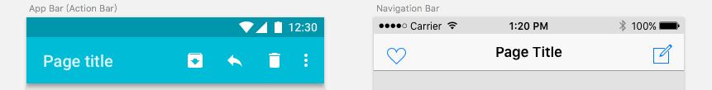
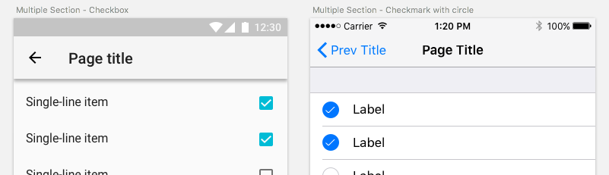
Background to UI Design and Prototyping
Design tools give lots of freedom, but software is full of constraints:
iOS vs. Android force different ways of doing the same thing
Android
iOS
Screenshots from https://medium.com/@chunchuanlin/android-vs-ios-compare-20-ui-components-patterns-part-1-ad33c2418b45
Notes:
Apple and Google have design guidelines for iOS and Android respectively.
Failure to follow rules can result in your app’s publication being denied

Slide 6
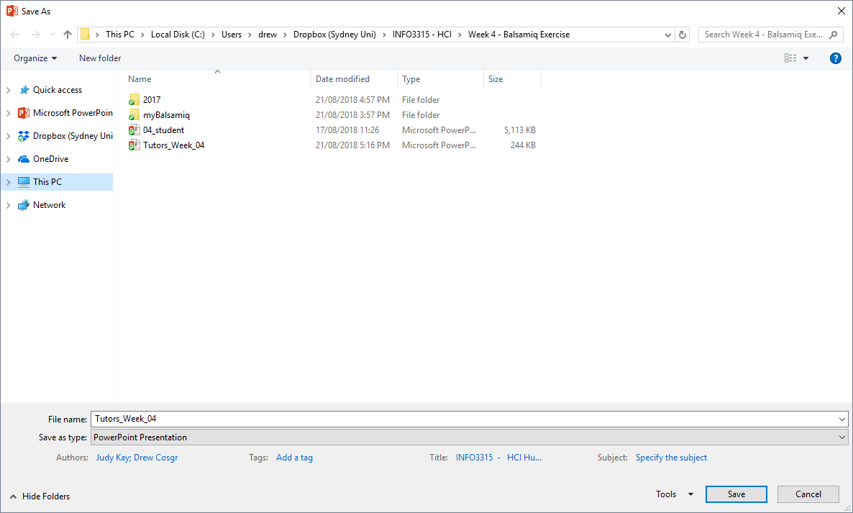
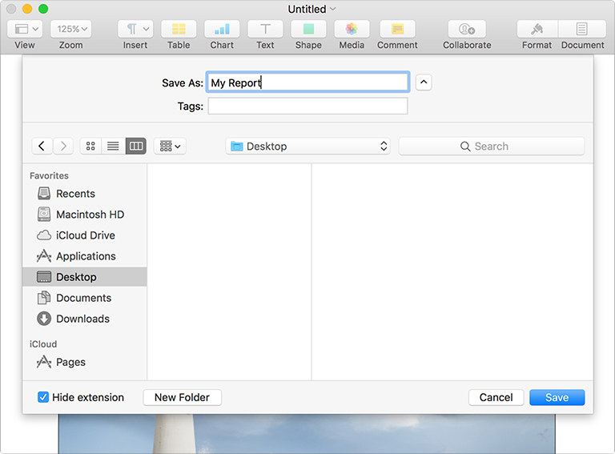
Background to UI Design and Prototyping
Windows vs. Mac force different ways of doing the same thing:
MacOS screenshot from https://developer.apple.com/design/human-interface-guidelines/macos/windows-and-views/dialogs/
Notes:
This shows a Save-As dialog in Windows and MacOS. Although the function is the same, the form is very different.

Slide 7
Balsamiq Rationale
Produces low-fidelity wireframes
Basic prototyping tools
Focus on function over form
Notes:
Low-fi prototypes: Producing high-fidelity prototypes can come later, once the assumptions of the design have been tested and proven against potential users
The sketch style in Balsamiq is intentional to help prevent leading the viewer into believing the wireframes represent completed visual designs
Focus on communicating functionality; wireframes are not for visual design
make sure the design works as intended, before focusing over how it looks

Slide 8
Setting up Adobe Flash

Slide 9
Wait? Flash!
It’s insecure and un-performant
It’s been deprecated since 2015
Adding a whitelist rule to allow only myBalsamiq should avoid exposing your computer to the worst of the internet
Note: These instructions only work for Google Chrome
Notes:
myBalsamiq is implemented in Flash
Most browsers no-longer ship with Flash, except for Chrome.
Even Chrome sets flash to disabled-by-default.
We have to add a whitelist rule to allow myBalsamiq to run.

Slide 10
Introduction to myBalsamiq

Slide 11
Create Your Account
What if I don’t have the invite email?
Check your student email account, including Spam folder
What if I still don’t have an account?
Ask your tutor to add you to your respective group

Slide 12
Managing your project
myBalsamiq needs to have each mockup explicitly saved – no autosave feature
Save early, save often
Add notes to help indicate purpose
Why was this change made?
Is it complete, or is there work outstanding?
Notes:
Page 12-13 of Lab Notes

Slide 13
Organising your mockups
In project home screen, or from Mockup Editor the mockup thumbnails can be dragged-and-dropped
Has no impact on navigation of prototypes, but helps with logical groupings
Notes:
Page 12-13 of Lab Notes

Slide 14
Linking Mockups
Links enable mockups to be navigated through to create a click-through prototype
You can interact with the prototype rather than see it as a static set of wireframes
Don’t try to force this into becoming a high-fidelity prototype, that comes later
Notes:
Page 15-16 of Lab Notes
Try to show using the single link controls, as well as the multiple linked controls (i.e. tab bars etc.)
Yes, the example in the notes is 2001: A Space Odyssey themed.

Slide 15
Assets
Assets allow images to be uploaded and used in myBalsamiq
Assets behave like normal controls
Might be used to add a logo – purely cosmetic, but may make a client happy
Or to add a graphic that is critical to testing a users understanding of the UI
Notes:
Page 17-18 of Lab Notes
Discourage uploading assets that recreate the whole UI in another tool. It completely defeats the purpose of using Balsamiq over something like Adobe XD.
This will be useful for the student’s assignment, as they can generate a chart or graph of their data in another specialist tool, and import that into Balsamiq.
--- End of Balsamiq exercise. At this point the students should have enough exposure to the concepts and terminology in myBalsamiq to complete Mini-Assignment 4.

Slide 16
Activity 2

Slide 17
Create Group Google Folder (10 mins)
Create a Google folder for the group’s work, including this class and invite
all members and
the tutor
to it to keep all work and type up the group’s work.

Slide 18
Activity 3

Slide 19
Share Task 1 from the mini-asst ++ (20 mins)
Share the Task 1 designs and rationales
Discuss these + designs seen in lectures this week and last.
Discuss relative strengths and weaknesses of each of above design approaches and.
Identify ideas that seem most promising.

Slide 20
Activity 4

Slide 21
Share Task 2 ++ (20 mins)
Share your individual goals defined within your group
Discuss and agree on the goals your group will tackle
Design the 3 abstract tasks
Design 2 concrete tasks for each abstract task
End: Create 3 * 2 concrete tasks you will prototype)

Slide 22
Activity 5

Slide 23
Co-ordinating group work (10 mins)
Decide on design approach
Allocate concrete tasks to team members
Plan group meeting

Slide 24
Overview
Getting started with Balsamiq (40 mins .. 50)
Group Google Folder (10 mins .. 60)
Share Task 1 from the mini-assignment .. design (20 mins .. 80)
Share Task 2 (20 mins .. 100)
Decide design approach, allocate concrete tasks to team members plan group meeting (10 mins .. 110)

